Slide 1
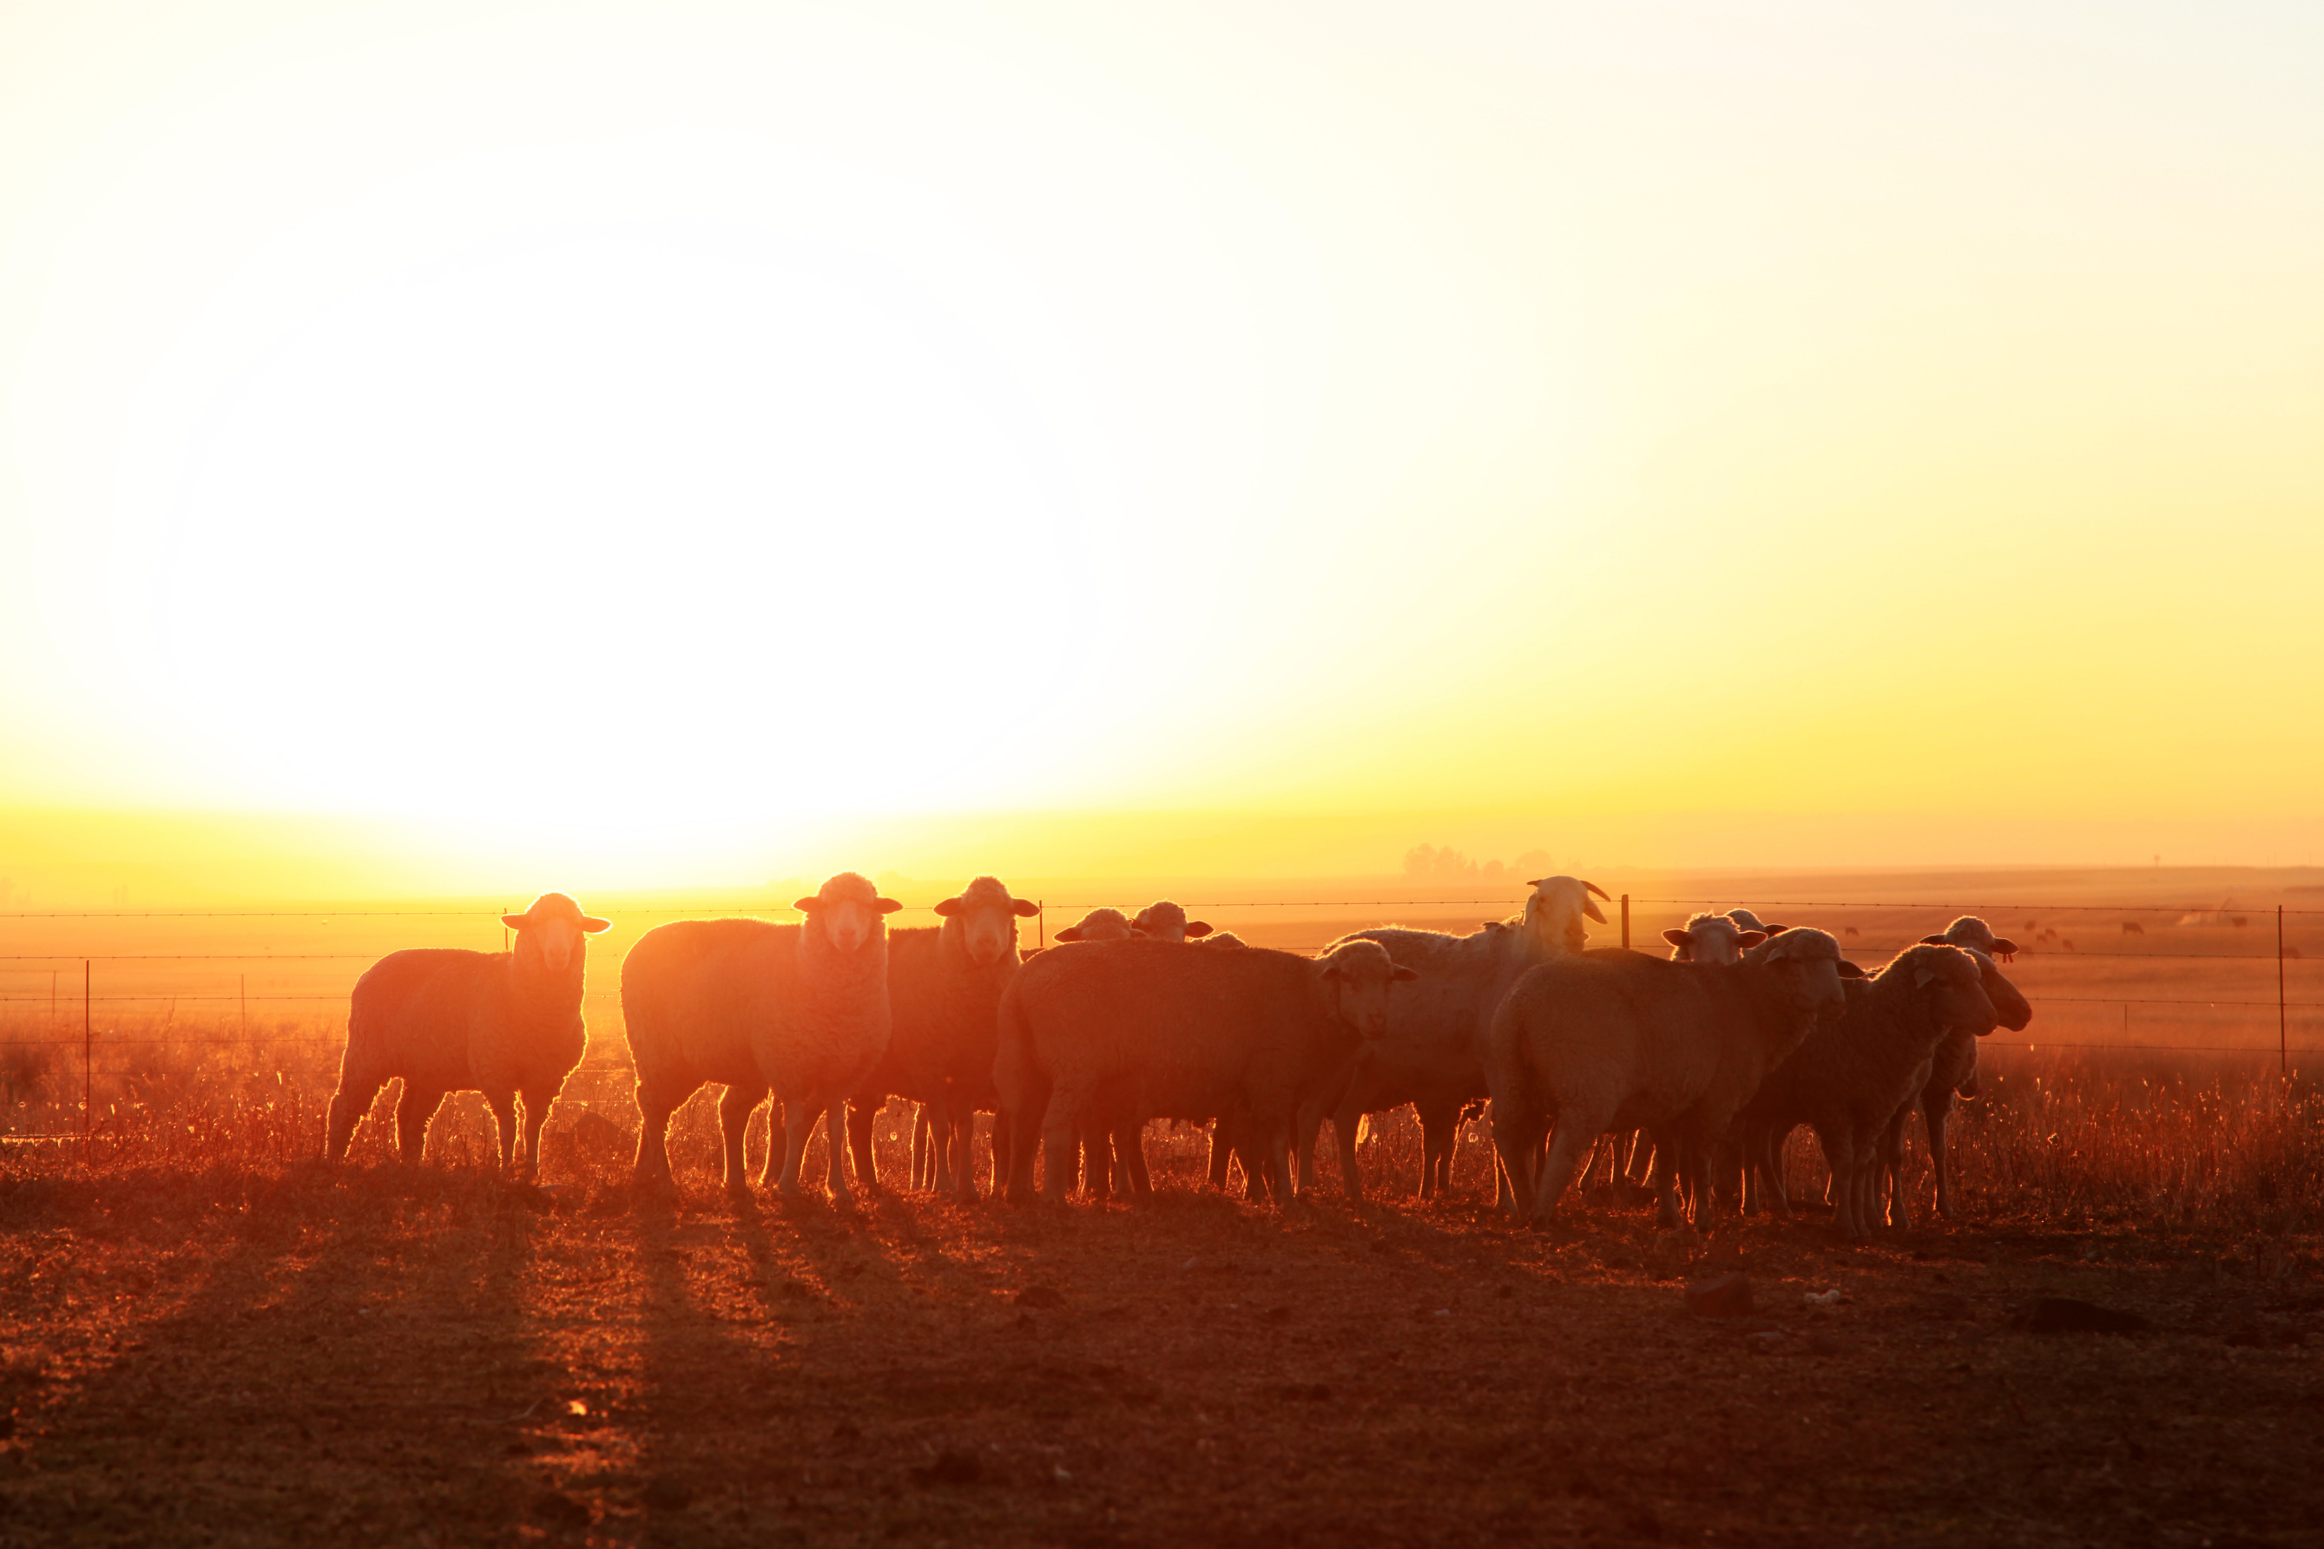

Dumbleyung Agtech Expo
23 July 2024

Slide 2
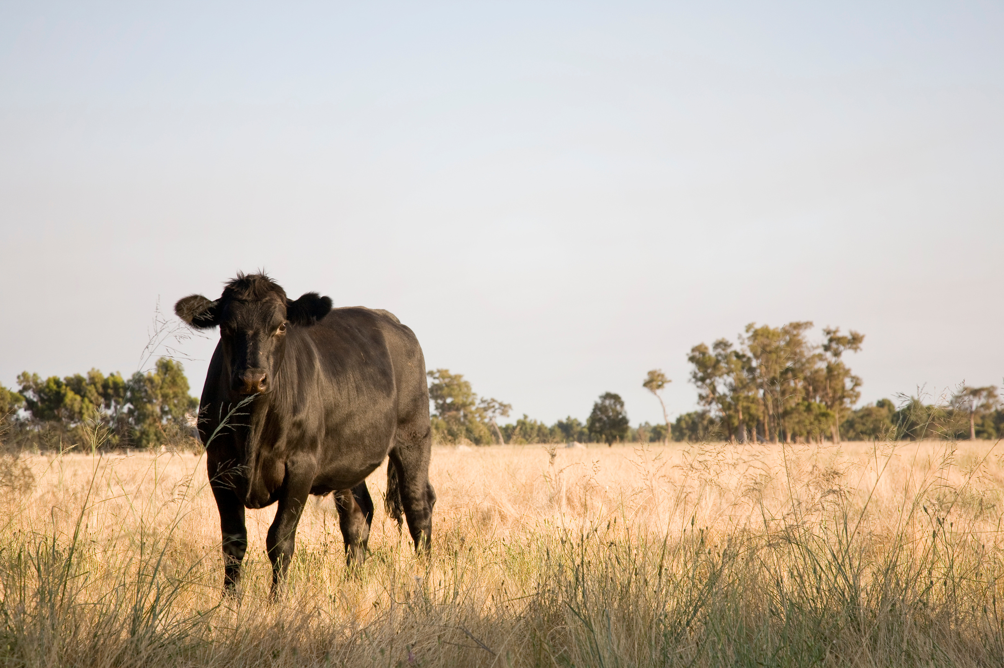

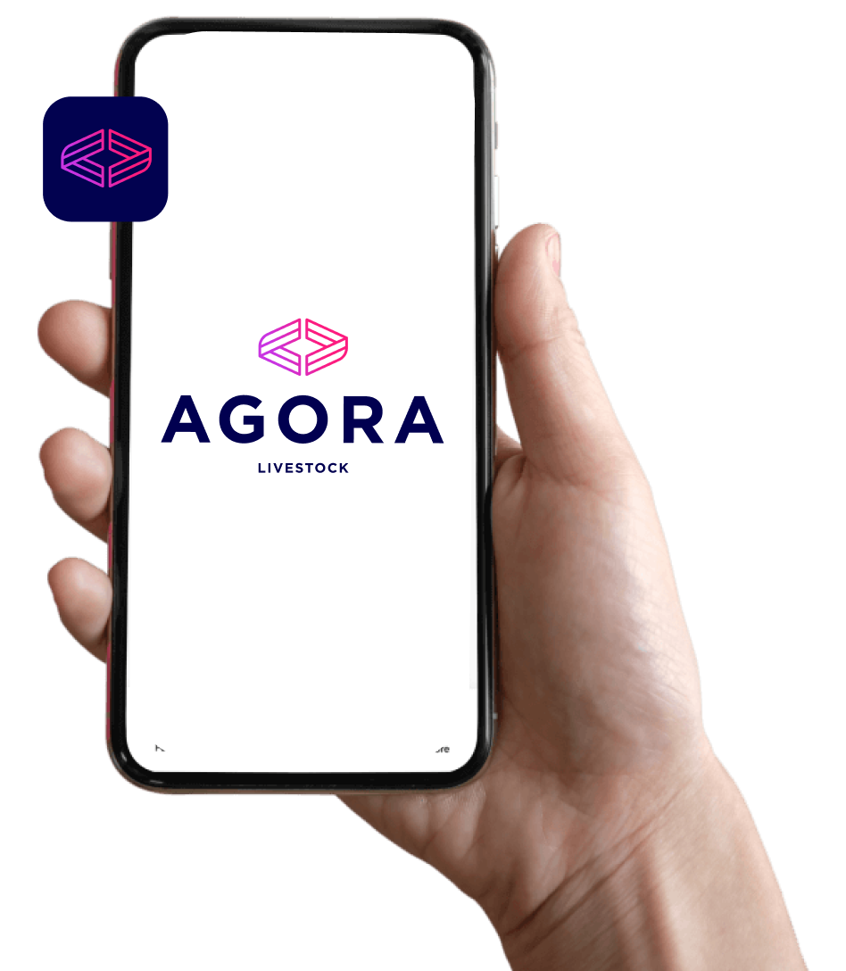
Background.
  Launched in 2018 as an independent source of livestock price information
  Over 10,000 registered users nationally
  Agora: marketplace in ancient Greece
Notes:
Key points
- General introduction
- Platform in market
- Good adoption, clear market need

Slide 3
Not having market information is profit destroying
Selling
at wrong time
Selling too cheap
Couldn’t find the buyer
Difficult to
budget
SELLERS
Hours lost
BUYERS
Buying at wrong time
Paying too much
Couldn’t find the seller
Hours lost
Unsure of position

Slide 4













Old Price Discovery

Slide 5

Agora Livestock

Slide 6
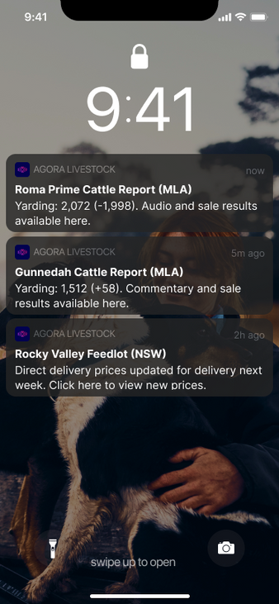
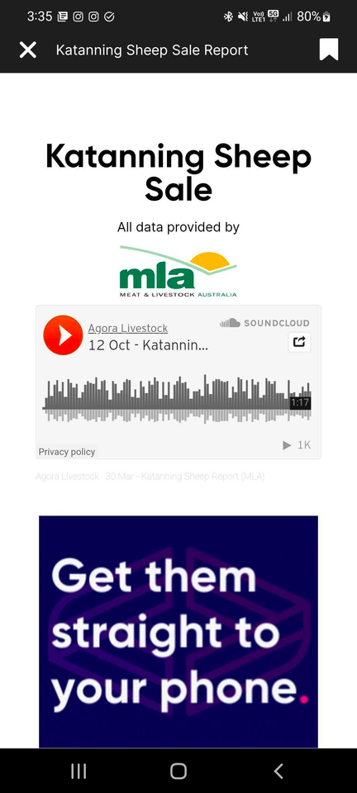
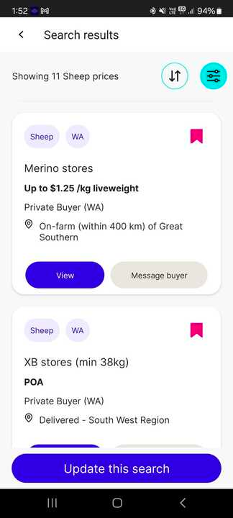
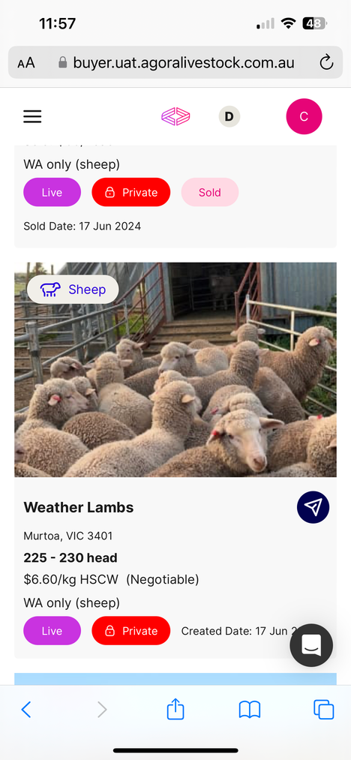
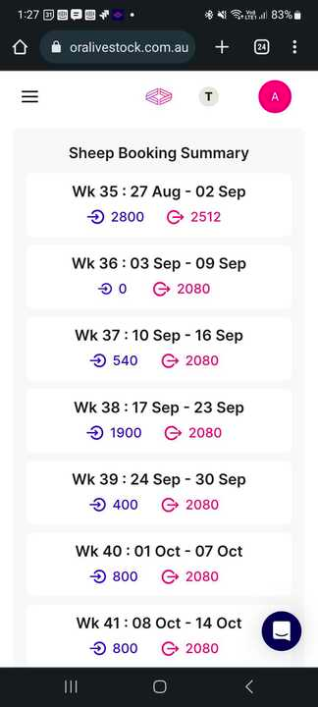

Agora Livestock

Slide 7
The Solution.
Faster, better market information
Public price grids
A marketplace

Slide 8
Revenue Model
SUBSCRIPTIONS
HOBBY
FREE
PRODUCER
$20/month
AGENT
$100/month
BUYER
$200/month
ENTERPRISE
$500/month
Price grids
Reduced brokerage fee
Deal Room
Private marketplace
Digital Stockbook
Booking confirmations
Stock required planning
Account manager
Saleyards
Price alerts
BROKERAGE FEES
14 DAY FREE TRIAL ON ALL PLANS
Cattle: 0.5%
Sheep & Goats: 1%
Success based. No Risk.

Slide 9
Building a product.
Innovation is not a straight line
Notes:
What are the things that will save you time
What are the jobs you do repeatedly that could be automated.

Slide 10
What can you do?
Be proactive
Engage and be vocal about what you want.
Ask for new features or improvements
Tell them what does and doesn’t work
Speak to the provider
Invest
Time. Money. Support. Feedback. Lobbying.
Notes:
What are the things that will save you time
What are the jobs you do repeatedly that could be automated.

Slide 11
Scan the QR to download the app
agoralivestock.com.au
1300 812 345

