Slide 1
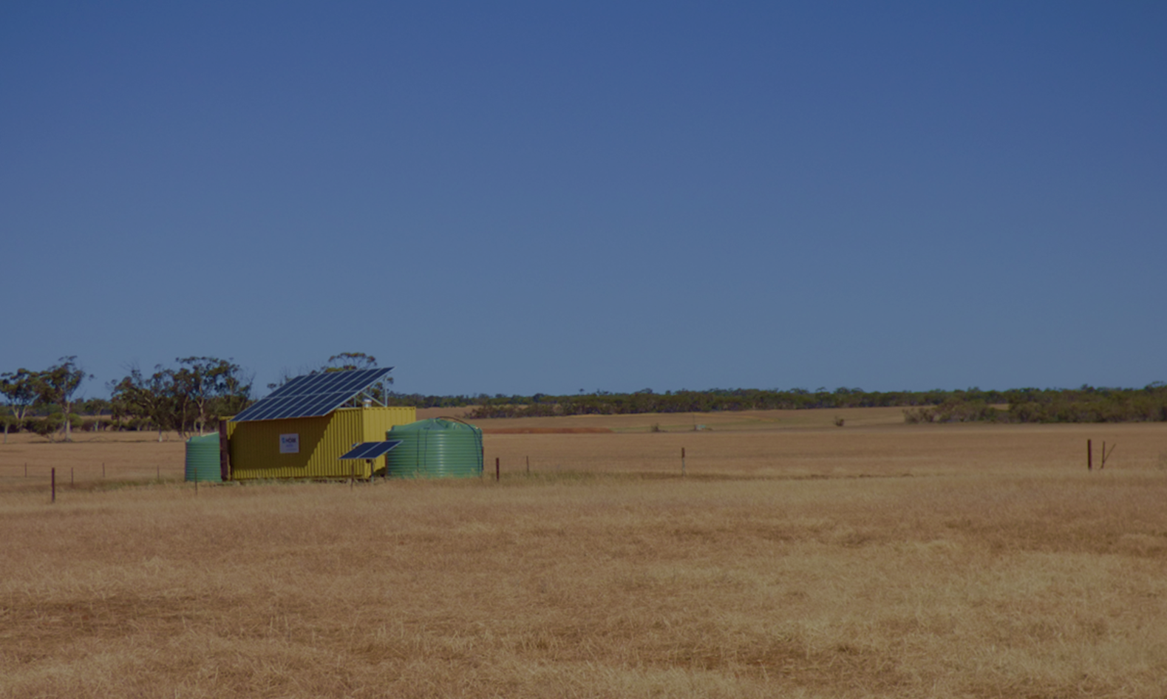
WaterSmart Farms
23 July 2024
Dr Richard George
Department of Primary Industries and Regional Development
Notes:
WaterSmart Farms evolved from the 2019-2020 dry seasons – in response to farmers saying they wanted new technologies to find, store and treat water.
From 40 field days, farmers told me to focus on new options for dry seasons
(DPIRD efforts had focused on Dams in the early dams (dams and roaded catchments)
In response we looked at 3 areas
And I brought together a range of partners (3 Universities), GGA, Agencies, etc
WaterSmart Farms
Groundwater – finding water deeper in the bedrock
Treating water (RO Desalination) – if its quality required reducing its salinity.
WaterSmart Dams
Engineering – new options for dams.
WaterSmart Industries
In 2024, we have started another project to find bigger resources in palaeochannels that can underpin communities and agri-industries (eg small horticulture, feedlots, abattoirs, etc)

Slide 2
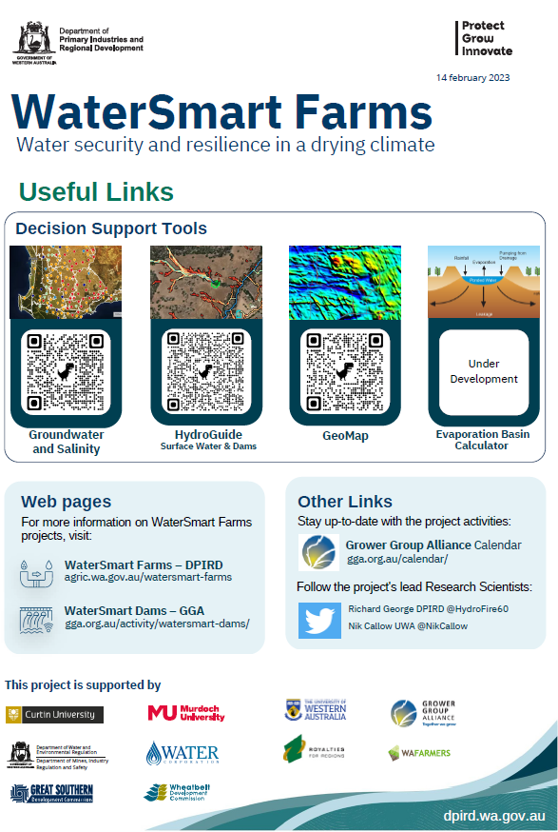
WaterSmart Farms
Partnership – ‘on farm’ reliable water
Groundwater and Desalination
Assessing early RO adopters and technology
Assessing new groundwater options and reject disposal
Assessing desalination equipment and related systems
WaterSmart Dams $4m partnership
Surface water – ‘making dams work again’
Federal Drought Fund and WA Climate Resilience Fund
Partnership - SW Drought Hub, GGA, 4 Groups, UWA and DPIRD
12 science via demonstrations…
WaterSmart Industries – $5m (new) – larger supplies, businesses
Notes:
The WaterSmart Farms and Dams projects started in 2021 an ends in 2025
THIS UPDATE REPORTS ON PROGRTESS TO DATE (April 2024)

Slide 3
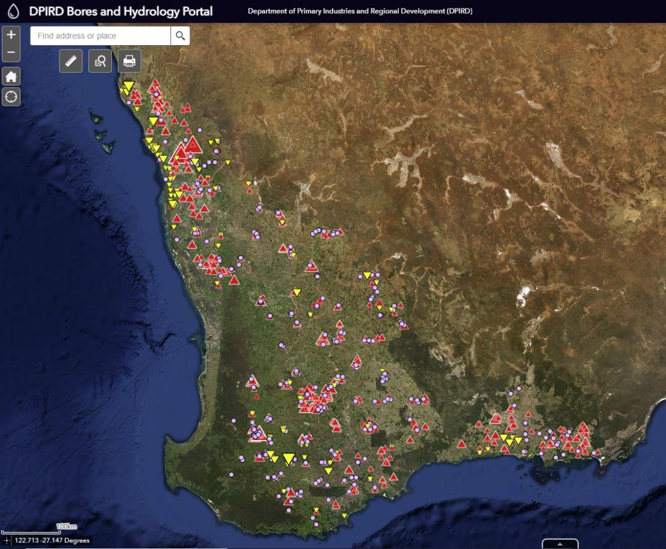
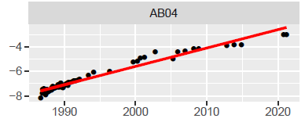
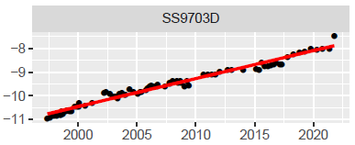
Wheatbelt – its dry?
Its full of water, but its often too saline, brackish or deep under rock
Its also still filling up
… contrast as SW water resources dry…
1000’s GL/a recharged
…and for the 70% of areas bores too saline to use
Where do you drill?
Notes:
Paradoxically – the wheatbelt is stil filling up with WATER
For almost 40 years we have measured watertables rising
This causes salinity
But it also is creating “water”
Why pump from the ocean, when we can access water under nearly every farm!!

Slide 4
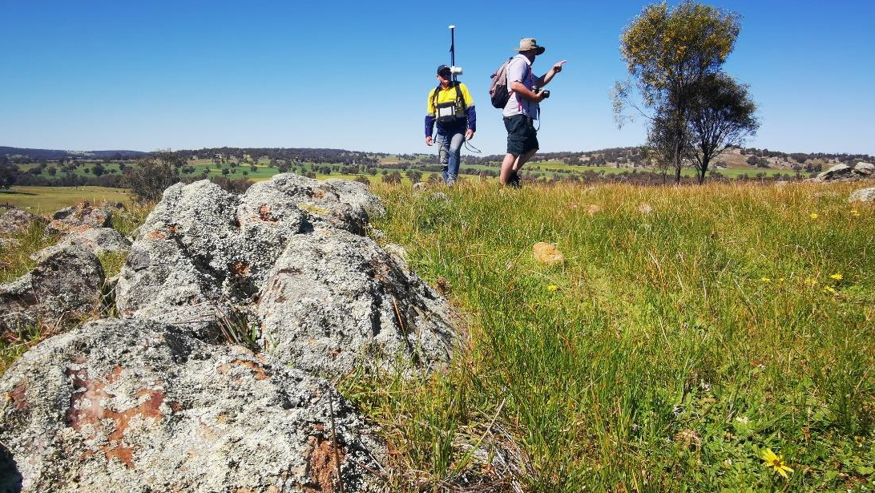
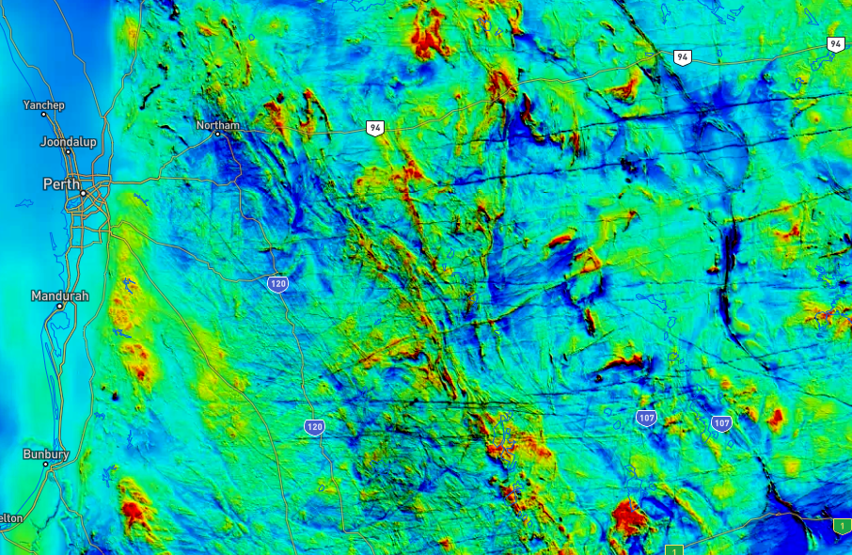
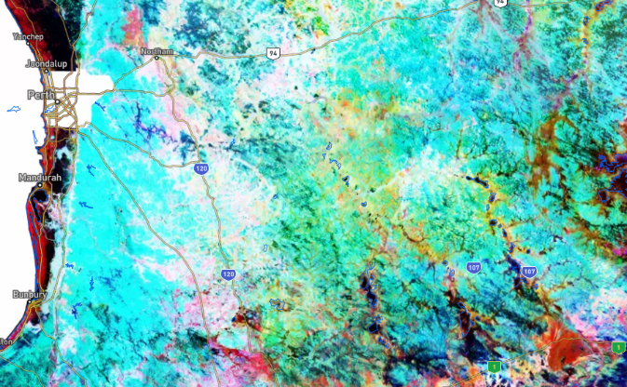
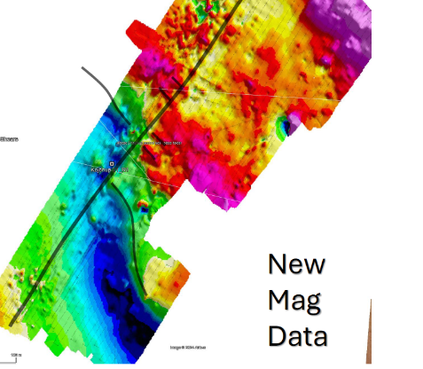
Finding Groundwater –
Geophysics
Notes:
So how do we drill to find groundwater
The Wheatbelt is covered by old mineral exploration data – magnetics (rock) and radiometrics (soils). Large image and smaller inset (left)
We have put that in the GeoMap webapp – DPIRD website
The image lower right – is field data, that we have acquired to find fractures in the bedrock that make water!!

Slide 5
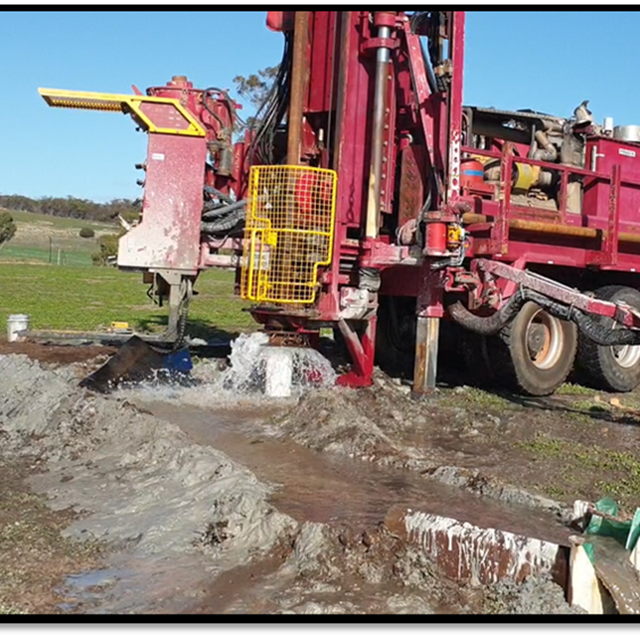
Fractured Rock – 60-120m holes
Of 17 completed
10 successful (> 1 L/sec)
5 over 3 L/sec
Salinity – all OK for stock
Farmer case studies (~ 20)
Example - York (2020)
Fracture at 70m
Yield airlift < 6 L/sec
2500 TDS
Notes:
WaterSmart farms technology
We drilled 16 bores at 13 farms
We has 9 successful, and some lower yiuelds.
Better than 50% success
5 bore - high yielding bores (maximum 10 L/second)
All holes able to be used for livestock

Slide 6
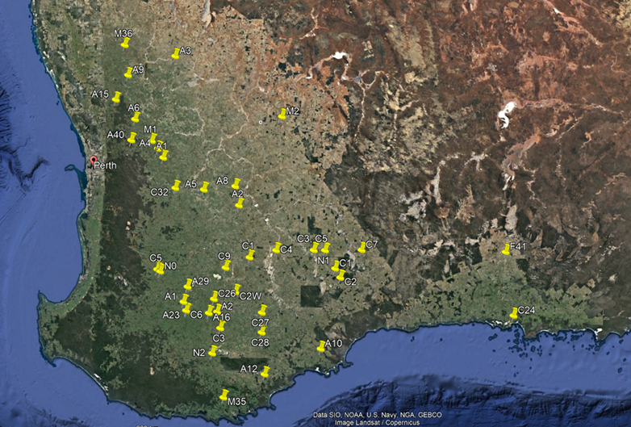
Desalination – Inventory - early adoption by farmers
51 existing farm RO units identified.
Inventory and analysis of performance, durability, maintenance and costs.
WaterSmart Farms

Slide 7
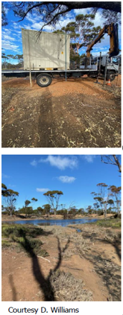
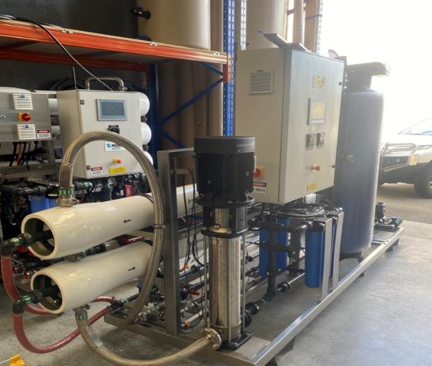
Community Desalination Units
Dumbleyung
18g/L feed, 10kL/day, 45% recovery
Existing bores place and existing dam for reject disposal
Katanning
8.5g/L feed, 20kL/day, 55% recovery
Existing bores place and existing evaporation dam already in use
Merredin
20g/L feed, 70kL/day, 40% recovery
Existing bores place and existing evaporation dam already in use, RO retrofit required
Notes:
So what if the salinity is too HIGH
We have assessed 30 farmer installed RO Desalination systems and with Murdoch University and monitoring 12
We have installed 4 units in 3 towns and 1 school (Wongutha CAPS - aborigonal agricultural training school)
We installed in towns so we could fast track installation (they had bores and evaporation basins)
We could also pilot in places of comunity need

Slide 8
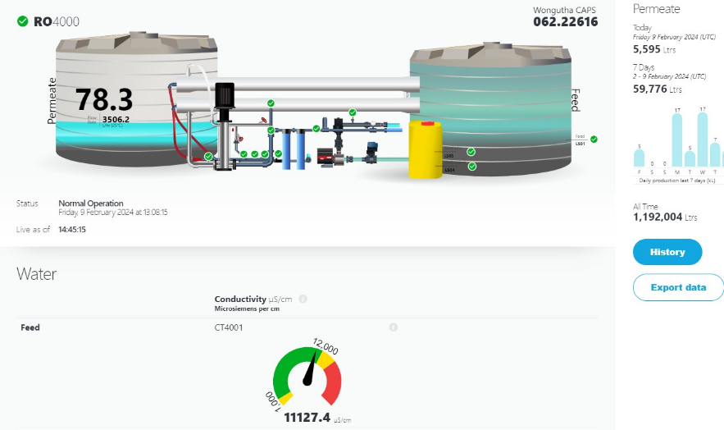
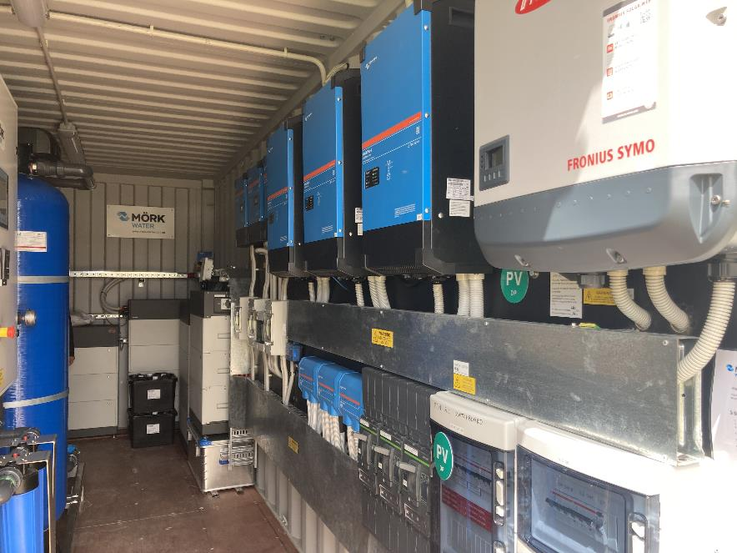
Wongutha CAPS - 30 kL/day, solar off 120 panels

Slide 9
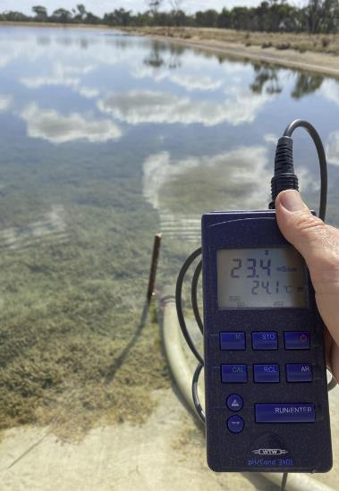
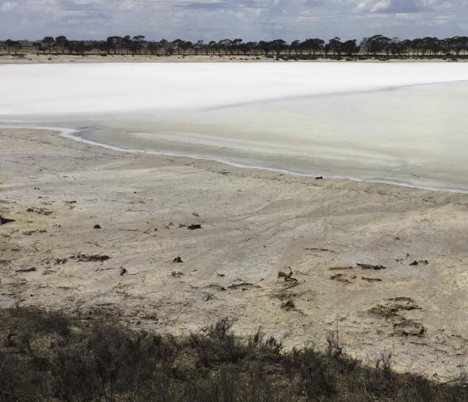
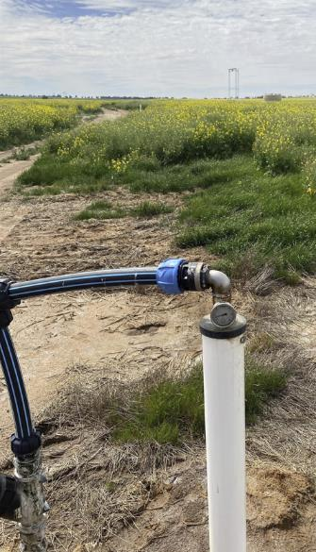
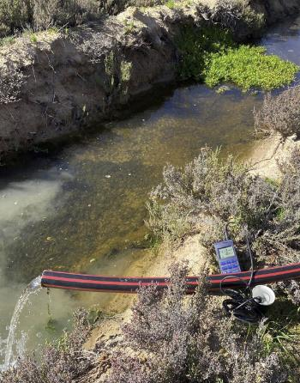
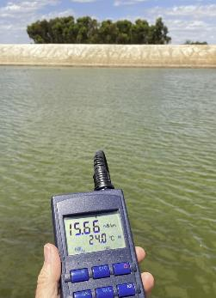
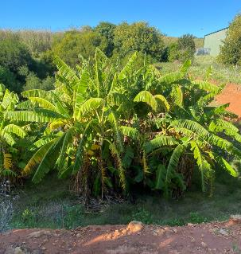
Reject water – managed by SLCAct
Reject bores
Evaporation basins
Farm salt lakes
Existing drains
Bio-receptors
Saline dams
Notes:
In all cases, DPIRD requires farmers installing RO plants to lodge a Notice of Intent to Pump saline water
There are many ways to manage the rejected water

Slide 10
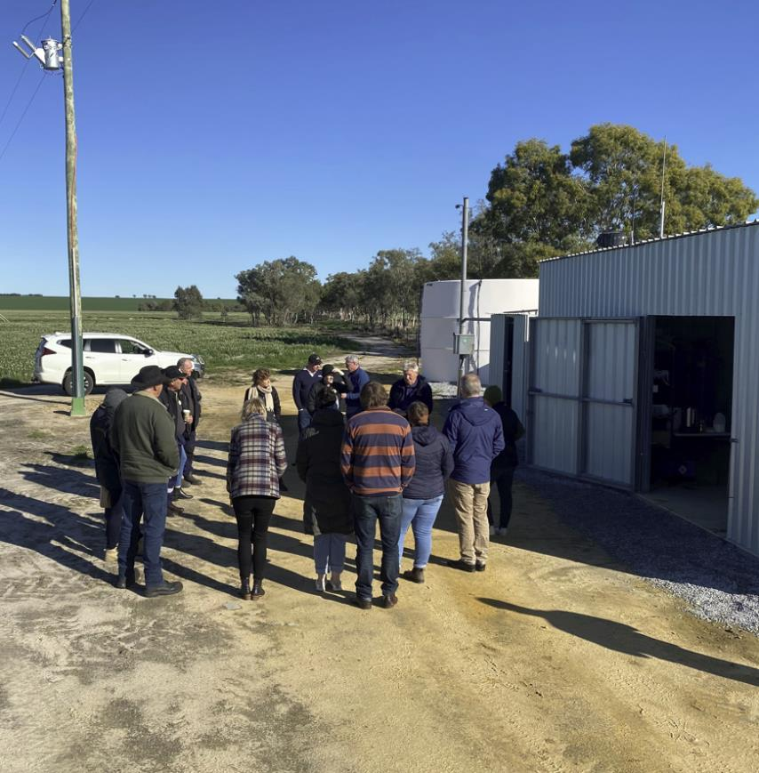
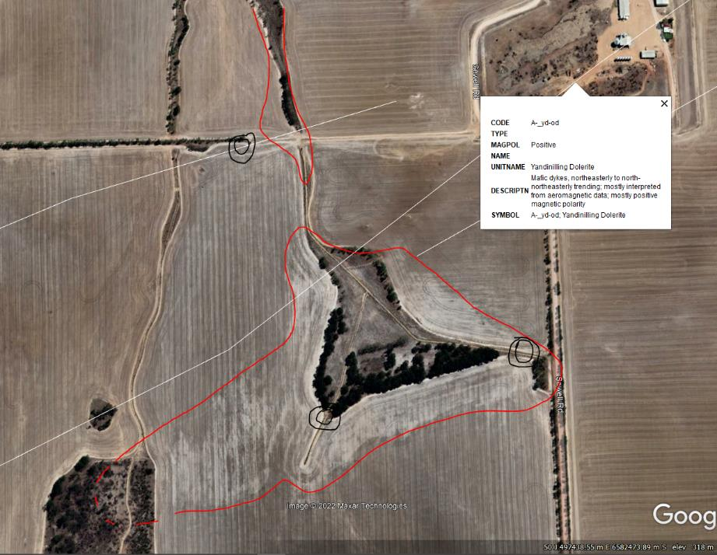
Ceres farm – Wongan Hills – added benefits
RO 60 kL/day from 3300 mg/L groundwater.
Reject 60 kL/d, at 6600 mg/L.
20 ha
Robert Sewell
Notes:
Here is one example
CERES farms have switched off their WaterCorp connections
They have a large RO plant that supplies up to 60,000 of water each day its required.
They supply their 6000ha crop program, and 3 gardens, sheds and general farm water
Its been operation 4 years
It has also remained about 30 Ha of saline sandy soils
______________________________________
Another sheep business near Kojonup has 3 RO plants to run 30,000 sheep and 5000ha cropping.
Bores for this farm are deep, and run from fractures

Slide 11
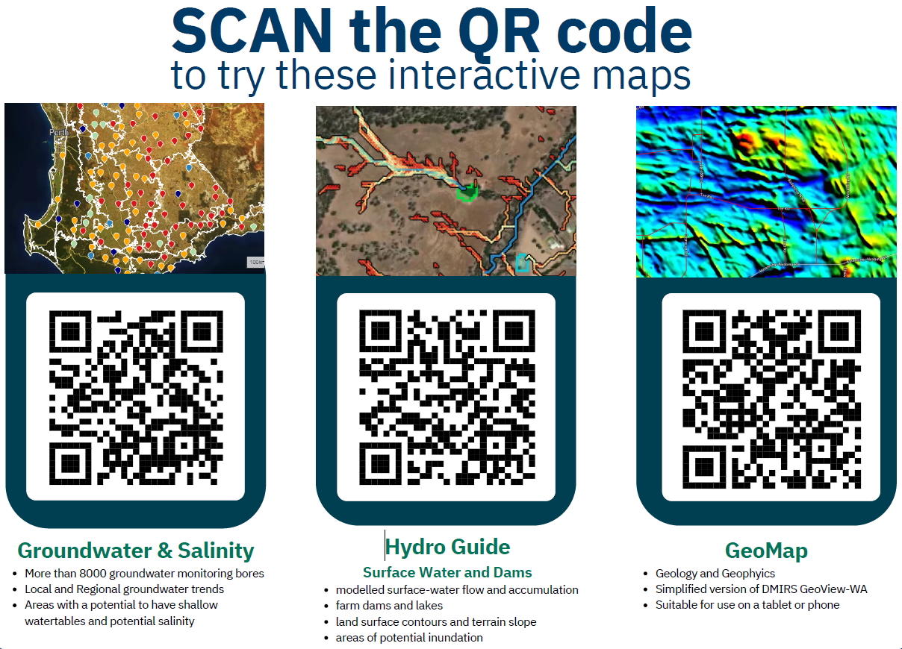
Questions
Notes:
Here are 3 tools available on DPIRDs website

